Slide 1

PDS4 Training Exercise
2017 Fall AGU Meeting
New Orleans, LA
December 12-15, 2017

Slide 2
Objectives
What you will learn…
Key components of a PDS4 archive
Basic structure of PDS4 metadata
What you will do…
Produce a set of valid PDS4 archive products
Training materials are available online:
  https://pds.jpl.nasa.gov/pds4/training/2017-agu/index.shtml

Slide 3


What are PDS and PDS4?
The Planetary Data System (PDS) is NASA’s repository for the distribution and long term preservation of NASA planetary data.
Planetary Data System
PDS Archive
The PDS Archive is the digital data repository maintained by PDS.
The PDS Standard are requirements and constraints designed to insure the usability of data in the PDS Archive throughout the lifetime of the archive.
PDS Standard
4th Edition
PDS4 is the latest version of the PDS Standard. PDS4 is not a data format!
PDS4

Slide 4
Fundamental Data Structures
PDS4 supports science data files which are describable using one of the following fundamental data structures:
Array – homogenous binary structures of 1 to 16 dimensions in which all of the elements have the same data type.
Table – ASCII or binary data with a repeating record structure made up of fixed-width fields.
Parsable Byte Stream – ASCII data with a repeating record structure made up of variable width fields separated by a field delimiter (e.g. CSV).
Encoded Byte Stream – Data which is formatted according some well known standard (e.g. PDF).

Slide 5


PDS4 Implementation
PDS4
XML Schema
PDS4
XML Schematron
PDS4
Metadata
The structure and content of PDS4 metadata is defined by a formal Information Model.
PDS4 is implemented in XML and expressed in terms of XML Schema and Schematron files.
Schema
Schematron
Information Model
  Schema define the metadata structure
  Schematron provide rule-based constraints on elements and content

Slide 6
XML
PDS4 metadata are formatted according to the eXtensible Markup Language (XML) standard.
XML
  XML is a markup language (similar to HTML).
  Values are placed between opening and closing tags:
  <tag>Value</tag>
  There are two types of tags:
    Attributes – simple elements containing values between their tags
    Classes – complex elements consisting of nested hierarchies of attributes and other classes
  XML is required to be “well-formed”:
    A single root class
    All elements consist of matching start and end tags
    Start, end, and empty tags must be correctly nested
    Characters are resticted to UTF-8 (use of “<”, “>”, and “&” is restricted)
    Element order is prescribed

Slide 7
PDS4 Products
PDS Product
1010000
1000100
1010011
0110100
0100001
Metadata
File
Archive File
Label
File
PDS Label
A file containing PDS4 metadata is called a PDS Label.
A PDS label along with the file or files that it describes constitutes a PDS Product.
PDS Product
  PDS4 labels are co-located with the files that they describe.
  All elements of a PDS4 archive are products.

Slide 8

PDS4 Archive Organization
Basic
Products
Basic
Products
Basic
Products
Basic
Products
There are 3 primary types of products in PDS4:
Basic Products
Basic Products are the smallest unit of a PDS4 archive. They consist of an individual label and the associated file or files.
1010000
1000100
1010011
0110100
0100001
Collection Products
Collection
Products
Collection Products
Related basic products of the same type may be grouped together into a Collection.
Collection
Bundle
Products
Related collections may be grouped together into a Bundle.
Bundle

Slide 9
Basic Products
Basic products consist of:
Basic
Products
  One or more archive files
  A PDS label file describing the content, and as appropriate, the structure of the labeled file or files
Basic products may be of many types (data, browse, documents, etc.).
Basic products are frequently referred to generically as “products”.
1010000
1000100
1010011
0110100
0100001
1010000
1000100
1010011
0110100
0100001

Slide 10

Collection Products
Collection Product
Collection products consist of two files:
Collection Inventory
  a Collection Inventory, a CSV file which contains a list of all of the basic products which are members of the collection
  a PDS label file which contains a description of the basic products contained in the collection, as well as a description of the collection inventory file
    The collection label file may optionally roll-up any metadata contained in the individual member products (e.g. targets, time ranges, etc.).

Slide 11

Bundle Products
Bundle
Products
A bundle product consists primarily of a PDS label file.
  A list of the collection products which are members of the bundle is included directly in the label.
  Optionally the bundle label file may also roll-up any metadata contained in the individual member collections (e.g. targets, time ranges, etc.).
  A bundle product may also include an optional “Readme” text file.
    The Readme file must either be plain ASCII text or UTF-8 format.
    It should include an overview of bundle content and organization.

Slide 12
Logical Identifiers (LIDs)
LIDs must be unique across PDS
LIDs take the form of a Uniform Resource Name (URN).
  Do not specify physical location
urn:nasa:pds:bundle:collection:product
Maximum length: 255 characters.
Segments are delimited by colons.
Allowed characters: lower case letters, digits, dash, period, and underscore.
Segments:
  1: URN identifier (static)
  2-3: Archiving agency (static)
  4: Bundle identifier
  5: Collection identifier
  6: Product identifier
Within the bundle, collection, and product identifiers dash, period, and/or underscore may be used as delimiters.

Slide 13
LID Segments
urn:nasa:pds:bundle:collection:product
Segments 1-3 are static
bundle is an identifier for the bundle and is included in the LID of all members of the bundle
  Must be unique across all of PDS
collection is a collection identifier and is included in the LID of all members of the collection
  Must begin with the collection type (data, document, etc.)
  Must be unique within the bundle
product is an identifier for the individual product
  Must be unique within the collection

Slide 14
Version Identifier
urn:nasa:pds:bundle:collection:product::ver
The product Version Identifier (VID) may be appended to the LID to form a LIDVID.
  A double colon (::) is the delimiter to separate the VID from the LID.
Internal references may be given either as LIDs or LIDVIDs.
  A LID refers to a product without specifying a specific version.
  A LIDVID refers unambiguously to a specific version of the referenced product.
PDS4 products primarily use a 2 component VID: M.n
  The major component (M) starts from “1”.
  The minor component (n) starts from “0”; resets whenever M is incremented.

Slide 15
Archive Bundle LID
The bundle product defines the bundle portion of the LID for its member collections.
The collection product defines the collection portion of the LID for its member basic products
Bundle Product
urn:nasa:pds:bundle
Collection Product
urn:nasa:pds:bundle:collection
Basic Product
urn:nasa:pds:bundle:collection:product

Slide 16
LID/LIDVID Usage
LIDs and LIDVIDs are used to identify a relationship between two PDS4 labeled products. Examples include:
Bundle
Product
Bundle
Product
  Inventories point from a product to its member products (solid lines):
    Bundle and collection inventories point to their respective collection and basic member products
Collection Product
Collection Product
Collection Product
  Internal References indicate a direct relationship between products (dashed lines):
    Bundle, collection, and basic products referencing related products of the same type
Basic
Product
Basic
Product
Basic
Product
Basic
Product
Basic
Product
    Bundle, collection, and basic products to relevant basic products (e.g. documents, context products, etc.)

Slide 17
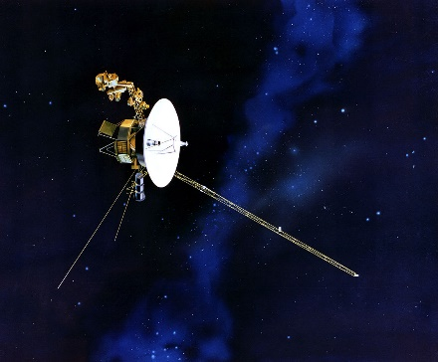
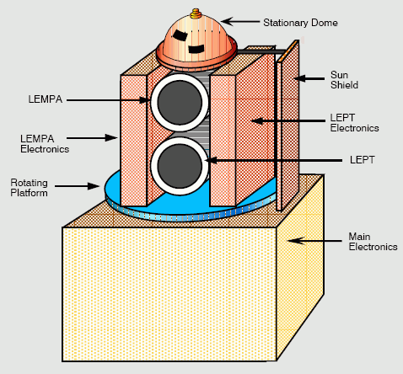

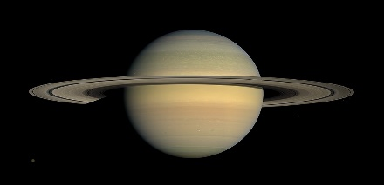

Context Products
Describe physical or conceptual objects which are not physically part of the PDS archive (e.g. institutions, missions, spacecraft, instruments, targets, etc.)
Provide the ability to indicate the association or provenance of other types of archive products by referencing the context product
Under the stewardship of (managed and maintained by) the PDS Engineering Node
Not designed to be user documentation for those objects

Slide 18
Archive Generation Procedure
Product planning and design should go from top down:
Bundle
Products
Collection Products
Basic
Products
Collections inherit the bundle ID from the LID of their parent bundle; basic products inherit the bundle and collections IDs from their parent bundle and collection.
Product generation should go from bottom up:
Basic
Products
Collection Products
Bundle
Products
Metadata from the basic products needs to be rolled up into the collection and bundles.

Slide 19
Archive Design
There is no hard and fast rule governing how a PDS4 archive is to be organized.
Data providers may want to consider the following questions:
Bundle I
Collection A
Collection B
Collection C
  What organization makes sense for the data?
  What are other data providers on the project planning to do?
  What are data users likely to find the most useful?
Bundle II
Collection D
Collection F
Consult with your curating node!

Slide 20
Anatomy of a PDS4 Label
XML Declaration
XML Declaration
XML identification tag
Schematron location information
Product (Root) Tag
Identification Area
Product Tag
Root product type tag
Namespace declarations
Schema location information
Observation/Context Area
Reference List
File Area

Slide 21
Anatomy of a PDS4 Label
Identification Area
XML Declaration
Contains product identifying information
  LID & VID definition
  Authorship/citation information (optional)
  Product modification history (optional)
Product (Root) Tag
Identification Area
Observation/Context Area
Contains product provenance/background
  Observation time
  Scientific content description (science discipline, data processing level, wavelength range, etc.)
  Target
  Source (mission, observatory, instrument, etc.)
  Discipline specific metadata (image display settings, geometry, etc.)
  Mission specific metadata
Observation/Context Area
Reference List
File Area

Slide 22
Anatomy of a PDS4 Label
Reference List
XML Declaration
Contains links to other PDS4 products (by LID/LIDVID) and external publications
Product (Root) Tag
Identification Area
File Area
Contains a description of the labeled file
  File name
  File statistical information (optional: size, creation date, MD5 checksum)
  File format information
  Data file structural information
    Array element descriptions
    Table record and field descriptions
Observation/Context Area
Reference List
File Area

Slide 23
PDS4 Build-A-Bundle Exercise
Archive Bundle Organization Design
Define Bundle and Collection Identifiers
  Bundle and collection LID definition
  Basic product LID formation rule
Generate Document and Document Collection Products
Generate Data and Data Collection Product Labels
Generate Bundle Readme and Label Files

Slide 24
Exercise Wrap-Up

Slide 25
Most Important Component
Communication!
Make certain to identify the PDS Discipline Node that will be curating your archive early in the process and communicate with them regularly!

Slide 26
PDS Discipline Node Contacts
Atmospheres Node
  Lynn Neakrase
  +1(575)646-1862
  lneakras@nmsu.edu
Cartography and Imaging Sciences
  Lisa Gaddis
  lgaddis@usgs.gov
Geosciences
  Ed Guinness
  guinness@wunder.wustl.edu
  Susie Slavney
  slavney@wunder.wustl.edu
NAIF (SPICE)
  Boris Semenov
  boris.semenov@jpl.nasa.gov
Planetary Plasma Interactions
  Joe Mafi
  jmafi@igpp.ucla.edu
Ring-Moon Systems
  Mitch Gordon
  mgordon@seti.org
Small Bodies
  Anne Raugh
  raugh@astro.umd.edu
  Jesse Stone
  jstone@psi.edu

Slide 27

Evaluation
Thank you for participating in our PDS4 training exercise. We would really appreciate your feedback on the quick survey below. Your answers are anonymous and are helpful to the development and improvement of our future training sessions.
https://goo.gl/forms/KmoOkTZrv1pgSs2z2
Thank you for your time!

Slide 28
Attributions

Slide 29
Backup

Slide 30
LID Bundle Identifier
urn:nasa:pds:bundle:collection:product
Must be unique within PDS
Bundle identifiers typically take the form:
  mission-instrument[-description]
  mission = The mission ID
  instrument = The instrument ID
  description = A description (optional) to help to distinguish the bundle from others from the same mission and instrument
Examples: ladee_nms, maven-swea-calibrated

Slide 31
LID Collection Identifier
urn:nasa:pds:bundle:collection:product
Must be unique within the bundle
Starts with the collection_type value (lowercase)
Collection identifiers typically take the form:
  collection_type[-description]
  collection_type = collection_type value (i.e. data, document, etc.)
  description = A description (optional) to help to distinguish the collection from others of the same type within the bundle (e.g. data type, mission phase, etc.)
Examples: data, data_calibrated, data-svy-3d

Slide 32
LID Product Identifier
urn:nasa:pds:bundle:collection:product
Must be unique within the collection
Typically consists of the base file name of the labeled file
Examples:
  nms_cal_hk__36127_20131203_104228,
  mvn_swe_l2_svy3d_20161208
Design notes:
  Uppercase characters must be converted to lowercase.
  File version numbers, and other variable portions of the file name should be omitted from the product identifier.

